Slide 1


2023 WSDM CUP 排序学习赛题详解
10月19日
20:00-21:00
助
Notes:
线上的观众朋友们，大家晚上好！欢迎来到AI TIME 直播间！我是今天的兼职主持人毛海涛。今天的主题是2023 WSDM CUP排序学习赛题详解 希望大家能在今晚有所收获。

Slide 2
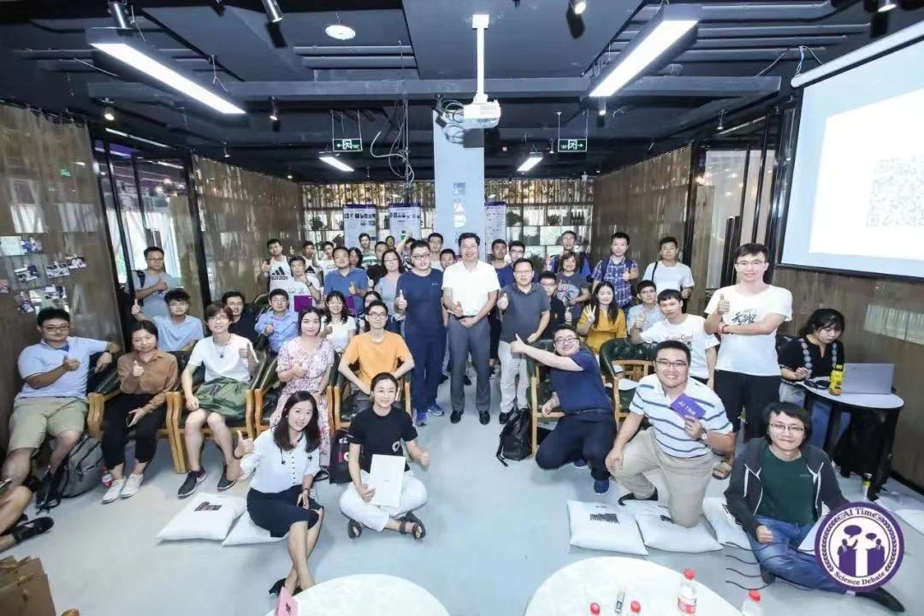
关于我们
AI TIME源起于2019年，旨在发扬科学思辨精神，邀请各界人士对人工智能理论、算法和场景应用的本质问题进行探索，加强思想碰撞，链接全球AI学者、行业专家和爱好者，希望以辩论的形式，探讨人工智能和人类未来之间的矛盾，探索人工智能领域的未来。
三年来，AI TIME已经邀请了800多位海内外讲者，举办了逾400场活动，超400万人次观看，汇集了全球逾百位志愿者团队；活动内容涵盖了AI领域的所有方向和AI+交叉领域的思想碰撞，主办与参与了丰富的多种活动形式：如世界人工智能大会、智源大会、政府产业论坛、大佬思辨、博士思辨、走进高校、技术分享、闭门脑暴会等。
Notes:
在正式开始之前呢，我先简单介绍一下AI TIME, AI TIME源起于2019年，旨在发扬科学思辨精神，邀请各界人士对人工智能理论、算法和场景应用的本质问题进行探索，加强思想碰撞，链接全球AI学者、行业专家和爱好者，希望以辩论的形式，探讨人工智能和人类未来之间的矛盾，探索人工智能领域的未来。AI TIME希望为大家提供一个非正式的，轻松的环境，让大家坐下来思辨讨论。希望大家从不同角度探讨AI，让AI的真理越辩越明。

Slide 3
AI TIME丰富的内容专题
专题 | 简介
AI TIME Debate | 邀请AI领域的顶级专家，针对前沿问题，对AI理论、算法与应用场景等进行深度探索与思辨。
AI TIME PhD Debate | 邀请海内外AI方向PhD，针对AI前沿学术问题，进行交流、探索与思想的碰撞。
AI TIME PhD | 邀请在AI顶会发表论文的PhD分享最前沿的研究成果，对相关学术议题进行交流探讨。
AI TIME 青年科学家 | 邀请海内外AI领域青年学者分享最新科研创新成果，促进青年人才的思维碰撞，搭建一个高质量的青年AI人才交流平台。
AI TIME 走进高校 | 邀请AI领域大佬一起走进国内各高校，多角度地探索AI的研究与应用，为高校和产业界建立一个共享、开放的平台。
AI TIME Master | 邀请世界级大师来做线上talk，与大家分享世界级科学家的前瞻性观点。
AI TIME 科普小课堂 | 针对大众关注的内容做科普分解，让更多的人了解AI,了解前沿科技。
百辨太魔人 | 邀请AI TIME的志愿者通过思辨的形式，以太魔人的真实经历为大家传递正能量。干货、有趣、接地气、共鸣，邀请观众与太魔人一起成长
科普大佬说 | 邀请AI 学术界与产业界的大佬针对人工智能领域的热点问题进行知识科普，追溯科学本质，探索科技前沿，带领大家一起走进人工智能的世界。
Notes:
自成办至今，AITIME已经举办了AI TIME目前已经超过400万人次观看，也产生了一大批粉丝。

Slide 4
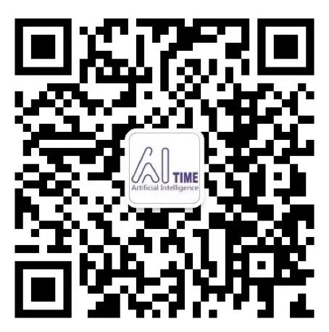
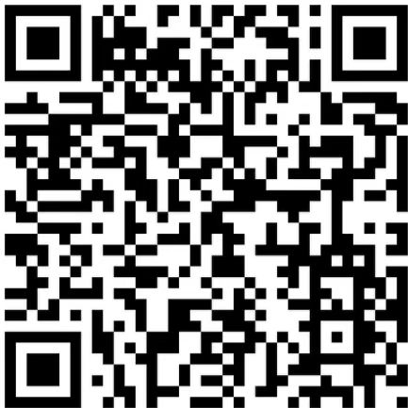
想与讲者和相关领域的优秀研究人员近距离交流吗？可以！请添加我们的“小A助手”（微信号AITIME_HY），回复关键词“PhD”即可拉您入群。
请大家关注AI TIME 官方公众号“AI TIME论道”（微信号lundaoAI）及微博账号@AITIME论道 ，更有超多报告PPT、往期精彩AI TIME Debate，AI TIME PhD学术分享的视频和独家资源报道等待小伙伴去挖掘宝藏哟~
添加“小A助手”
回复关键词“PhD”入群
关注公众号
“AI TIME论道”
关注微博账号
@AITIME论道
Notes:
大家可以通过添加我们的“小A助手”,回复关键字 PhD，就会有小伙伴拉你进群，结束后，大家也可以在群中继续讨论交流。
也欢迎大家关注AI TIME论道公众号和微博账号持续关注我们的活动，也有王琦的精彩报告等待大家去发现

Slide 5

AI TIME志愿者——我们都是太魔人
AI TIME的志愿者团队来自五湖四海。他们就读或毕业于海内外高校：清华大学、北京大学、北航、帝国理工、密歇根大学…一起带来多元的文化视角。在不同之外，Ta们共享着同一个理念：尊重科学、尊重思辨、尊重每一个人。
AI TIME志愿者团队欢迎关注AI的有活力和精力的小伙伴加入我们来共享共建这个AI乌托邦。在这里，你将有机会与世界级的AI专家当面请教，与一流学府的精英学子互相学习，与一线企业或独角兽中的技术大拿分享心得。
Notes:
我作为我们AI TIME志愿者的一分子，我也宣传一下我们的太魔人组织。

Slide 6

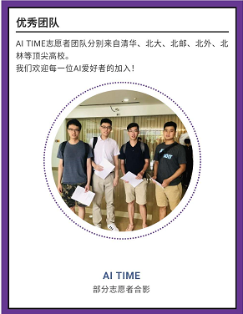

欢迎加入AI TIME，遇见太魔人
感谢AI TIME大家庭中的每一位讲者与志愿者！
欢迎每一位喜爱AI的小伙伴加入我们呀！
3月19日
19:30 -21:00

Slide 7
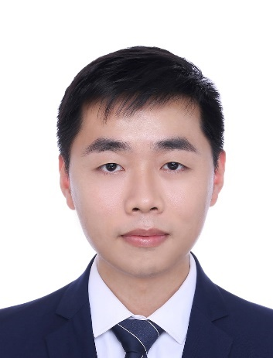
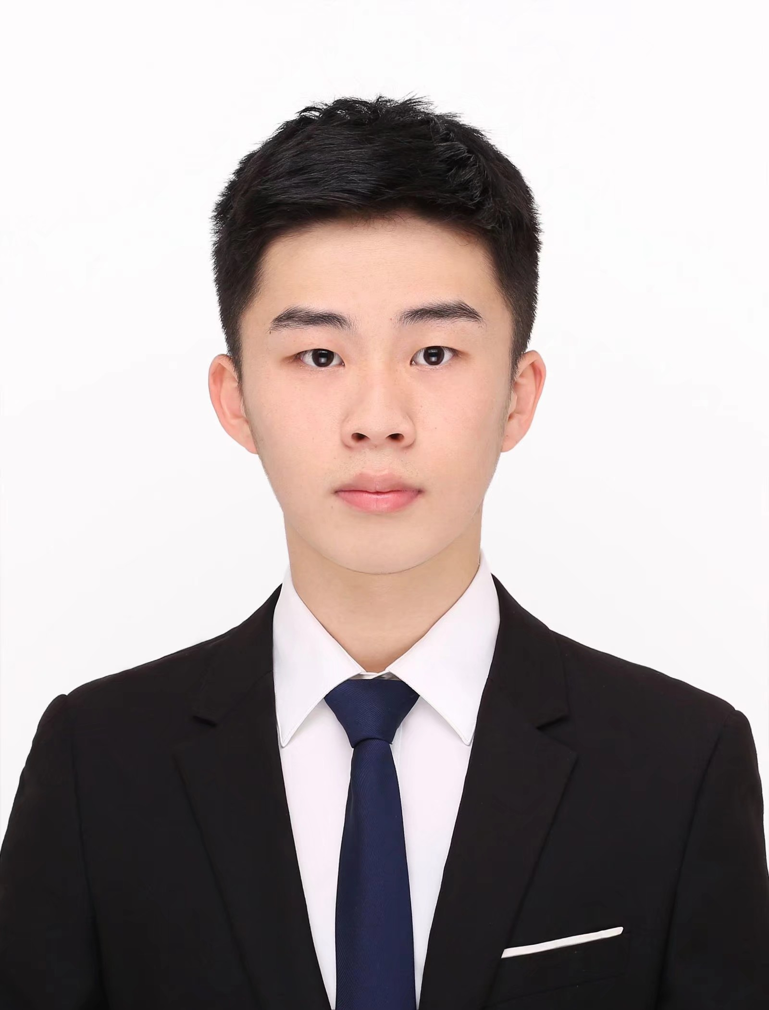
本期讲者
邹立新，百度大搜资深算法工程师，2020年博士毕业于清华大学计算机系，同年AIDU计划加入百度，在上层排序组先后负责大搜深度语言匹配和点击率预估等核心方向。目前，在相关方向顶级学术会议上发表学术论文20余篇，获2019年KDD Cup Runner Up Award。
毛海涛，密歇根州立大学一年级博士生，师从汤继良教授，曾以一作身份获CIKM2021 best short paper。

Slide 8
Unbiased Learning & Pre-training for Web Search
Lixin Zou, Haitao Mao
Joint work with Xiaokai Chu, Wenwen Ye, Changying Hao, Shuaiqiang Wang, Dawei Yin, Jiliang Tang.

Slide 9
Outline
A brief introduction on Learning to Rank tasks
Dataset introduction
Task submission guidance
Experiment & data analysis & Further discussion

Slide 10
A brief introduction on learning to rank tasks

Slide 11

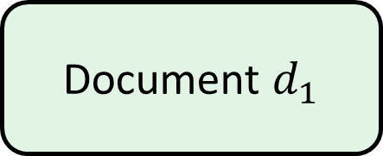
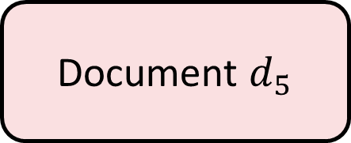
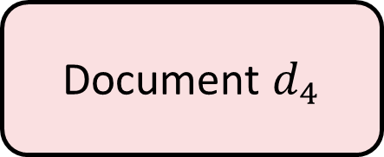
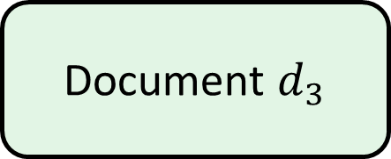
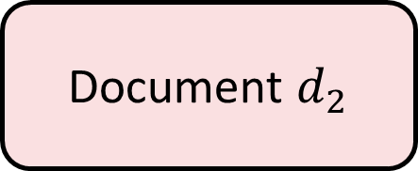
Brief Introduction
Document $d_{1}$
Document $d_{2}$
Learning to Rank (LTR) rank the document with higher relevance to query higher position
Unbiased Learning to Rank (ULTR) Learn an ideal relevance model with biased click model
Pre-train Language Model Learn a relevance model with the help of pretraining.
Document $d_{3}$
Document $d_{4}$
Document $d_{5}$
Notes:
Learning to Rank (LTR) aims to measure documents’ relevance w.r.t. queries.
It is a popular research topic which has much applications in web search engines, e-commerce, and multiple different streaming services.
However, it is hard to obtain the expert annotation relevance score since it is expensive and label-intensive.
Then we turn out to use the implicit user feedback, the click instead of the annotated relevance score.
However, click is biased on the displayed feature, which may leads to a biased system
Then Unbiased learning to rank is propose to learn an unbiased model based on the click

Slide 12
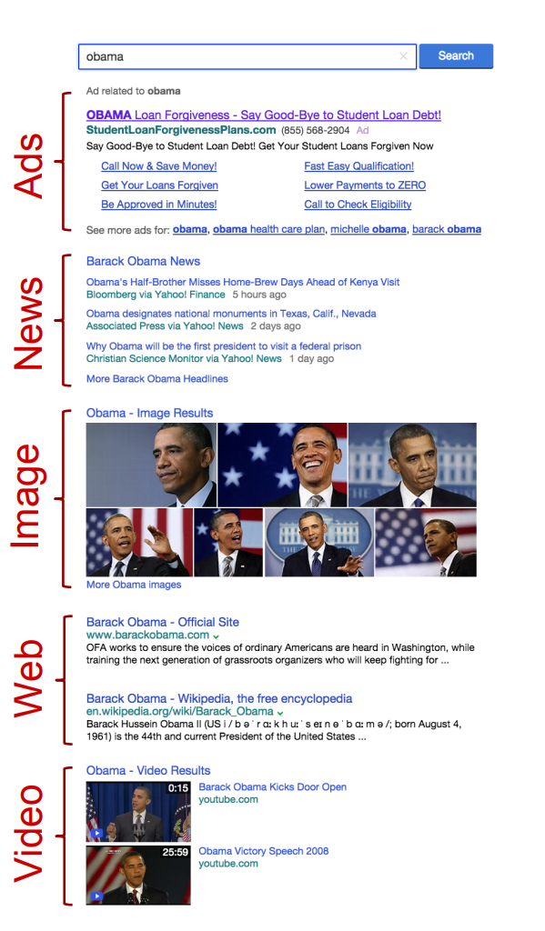
Challenge in ULTR
The user behavior is complicated rather than just simple click.
The user behavior can be affected by different display feature rather than just simple position.
Existing academic datasets only consider position and click.

Slide 13
Challenge in pre-training
No dataset provides the raw text information, only processed feature.
There is no consensus about pre-training task for web search.
How can a ranking-model query-document relevance relationship is an non-trivial problem

Slide 14
Dataset Introduction
Notes:
Then we would like to introduce what is our ideal dataset should be, the the real-world problems we are facing and how we build our dataset correspondingly.
Real-world Challenge & our dataset

Slide 15
What we want toward an ideal dataset
The training and evaluation procedure similar with the real- world scenario
The dataset more like the real-world scenario
The dataset can allow us utilize the advanced techniques
Notes:
In the real-world scenario, we
Take an example, Unbiased learning to Rank also utilize the text information in query and documents. Therefore, we should can use the pretrain-finetune technique with the attention-based big model.

Slide 16
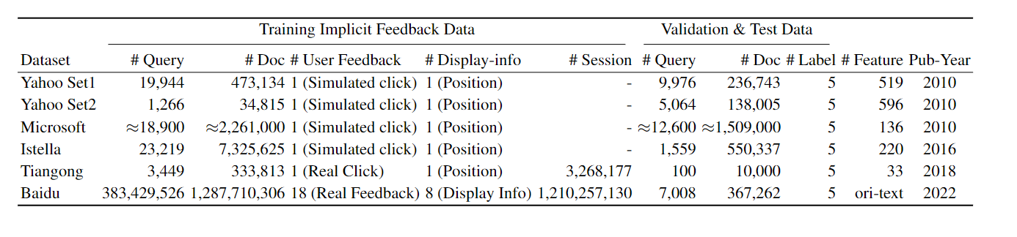
Practical train and evaluation prototype
Table 1: Characteristics of publicly available datasets for unbiased learning to rank
Pipeline: (1) click data for training (2) annotation data for evaluation
Existing datasets utilize synthetic data for training, and small annotation set
Provide real-world click data and a fairly large testset

Slide 17
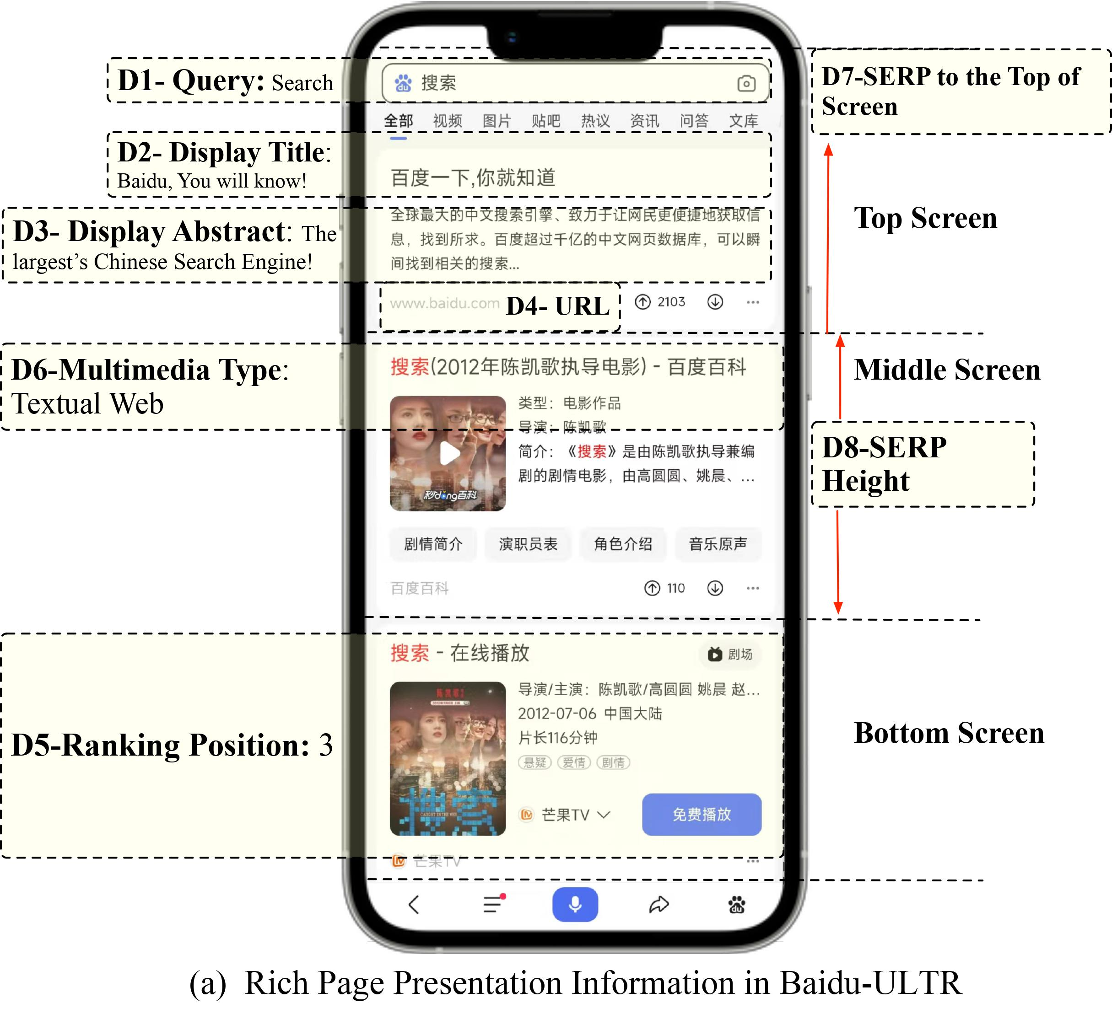
Dataset more like real-world scenario
Previous datasets only provides position, the only one page presentation feature.
The new modern search engine can provide more page presentation features

Slide 18
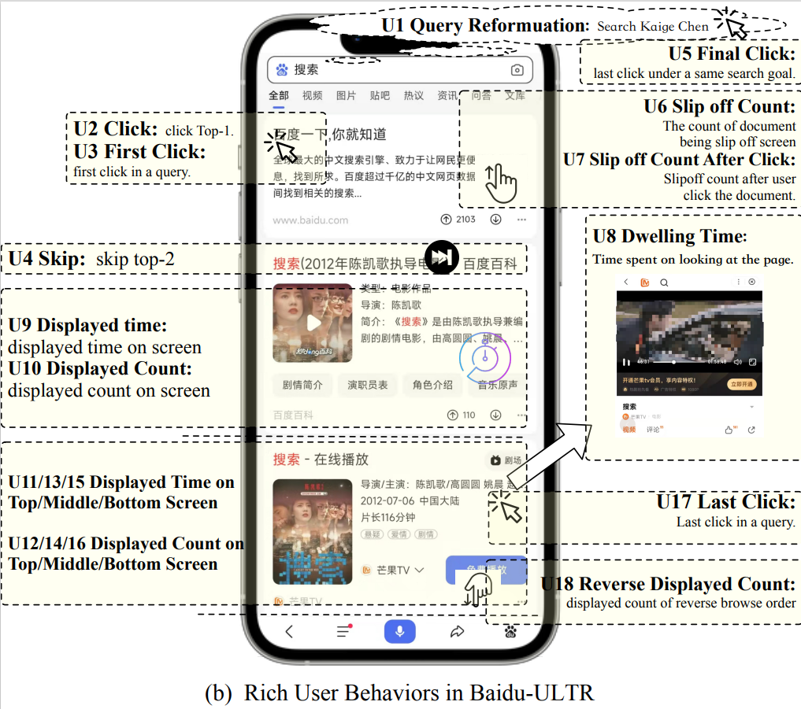
Dataset more like Real-world scenario
More user behavior: Click may not be the only signal for ULTR
Notes:
Query Reformulation, click, first click, skip, final click, slip off count, slip off count After click, Dwelling Time, Displayed time, Displayed Count, Displayed Time on Top/Middle/Bottom Screen, Displayed Count on Top/Middle/Bottom Screen, Last click, Reverse Displayed Count.

Slide 19
Utilize more advanced techniques
Large-scale pretrain model, e.g., BERT, ERNIE, are common utilized in Natural Language Processing.
Existing datasets provide only provide preprocess features, e.g., tf-idf, BM25
Baidu-ULTR provides raw tokens after desensitization.
The dataset size is 20 times larger than existing datasets.
Notes:
词表那个事情应该怎么说
Notice that, there are some research on the large-language mode in learning to rank, however, only from the industry perspective, no open dataset is available.
Drawback: inconvenient model transfer

Slide 20
Tasks

Slide 21
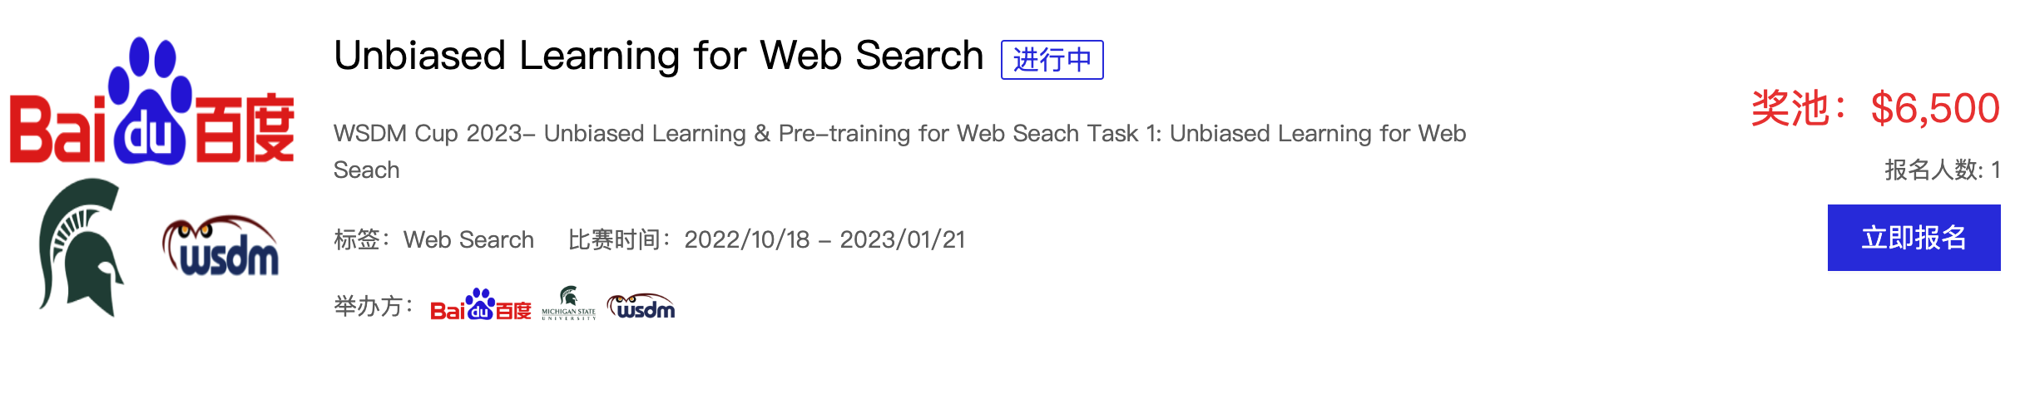
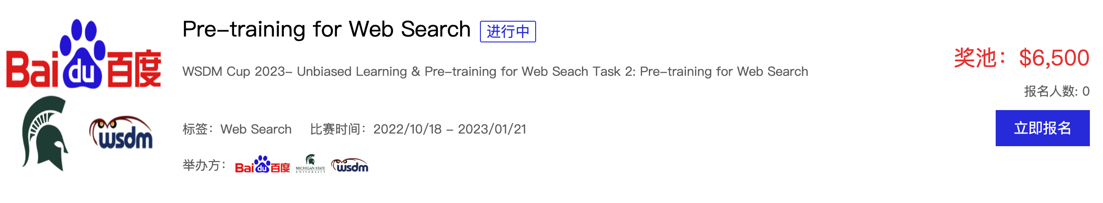
WSDM Cup 2023
Baidu and MSU co-host the WSDM Cup 2023 -- Unbiased Learning & Pre-training for Web Search

Slide 22
Important Timeline
Event | Complete Date
Oct 18 2022 | Website ready and training set available for download.
Nov 11 2022 | Intermediate test set release and intermediate submission starts.
Dec 11 2022 | Intermediate submission ends.
Dec 16 2022 | Intermediate leaderboard result announcement.
Dec 17 2022 | Final test set release and final submission starts.
Jan 11 2023 | Final submission ends.
Jan 15 2023 | Final leaderboard result announcement.
Jan 25 2023 | Invitations to top 6 teams on each sub-task for short papers.
Feb 15 2023 | Short paper deadline.
Feb 27-March 3 2023 | WSDM Cup conference presentation in person for top 3 teams on each sub-task.

Slide 23
Prizes ($13000)
Unbiased Learning
Champion: One team ($2000)
Runner-up: One team ($1000)
3rd-place: One team ($500)
We will sponsor for one conference registration ($1000) for top-3 team.
Pre-training
Champion: One team ($2000)
Runner-up: One team ($1000)
3rd-place: One team ($500)
We will sponsor for one conference registration ($1000) for top-3 team.

Slide 24
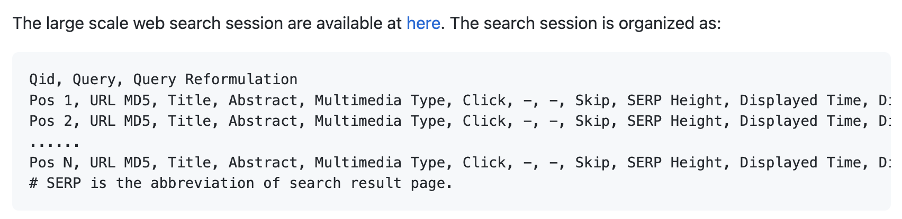
Dataset – Large Scale Web Search Session Data
Qid, Query, Query Reformulation
Pos 1, URL MD5, Title, Abstract, Multimedia Type, Click, Skip, SERP Height, Displayed Time, Displayed Time Middle, First Click, Displayed Count, SERP's Max Show Height, Slipoff Count After Click, Dwelling Time , Displayed Time Top, SERP to Top , Displayed Count Top, Displayed Count Bottom, Slipoff Count, Final Click, Displayed Time Bottom, Click Count, Displayed Count, Last Click , Reverse Display Count, Displayed Count Middle

Slide 25
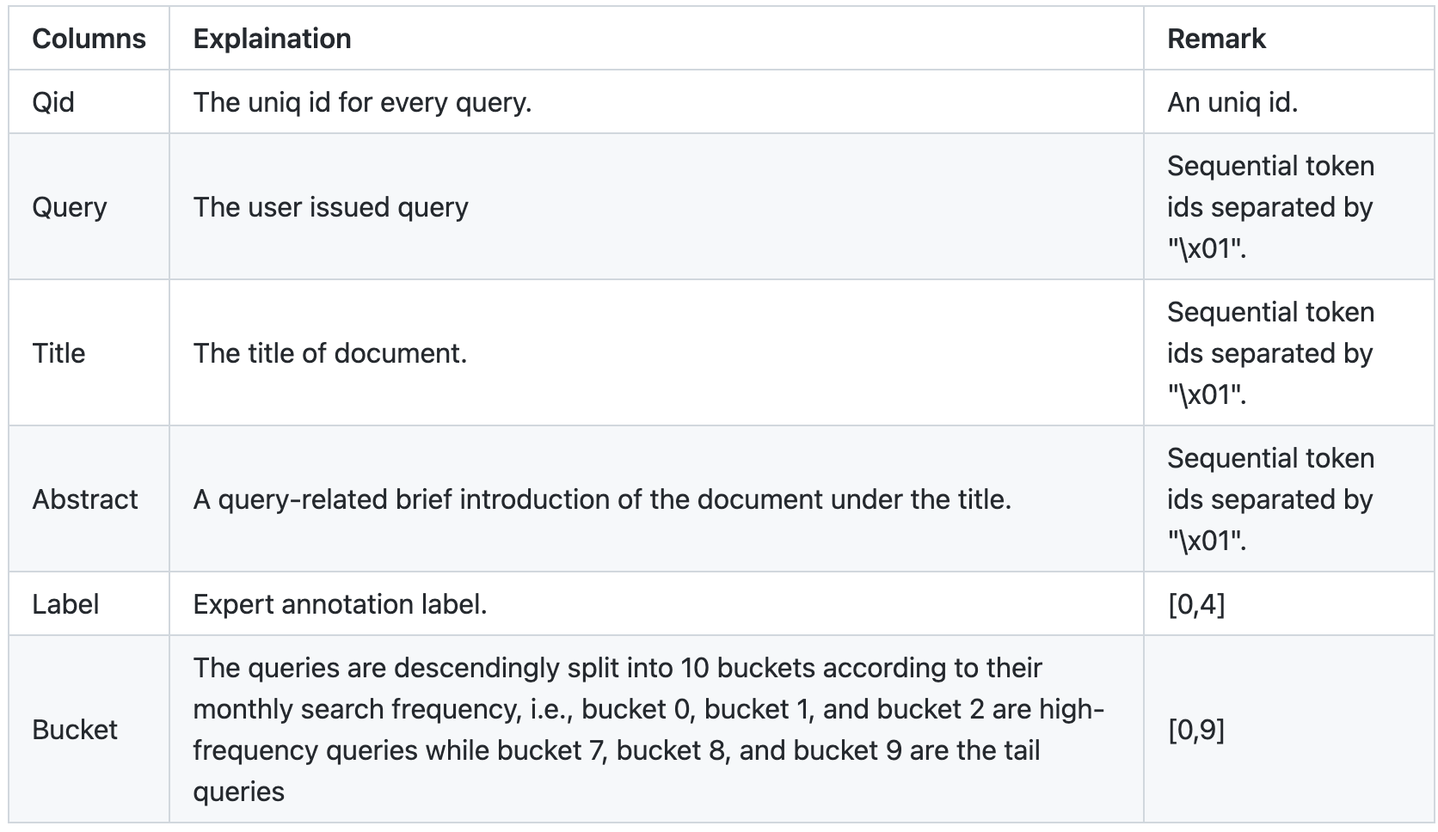
Dataset – Expert Annotation Dataset

Slide 26
Task 1: Unbiased Learning for Web Search
Task Description
Train a ranking model with the Large Scale Web Search Session Data.
The Expert Annotation Dataset and extra datasets are not allowed for training the ranking model.
The award will be honored to the teams with the code that can reproduce their results.
Evaluation
Evaluation Metric DCG@10

Slide 27
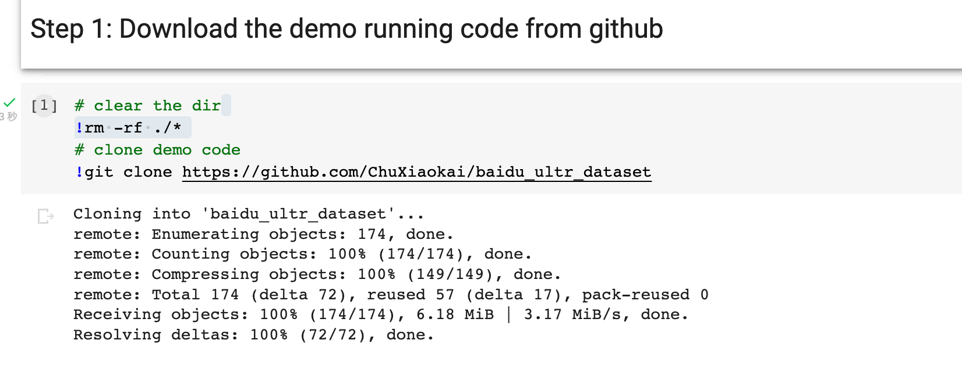
Unbiased Learning Step by Step Demo
Running demo: https://colab.research.google.com/drive/14-AlQkBp8EaTv2xiA-EINLhR9dycDkH1?usp=sharing

Slide 28
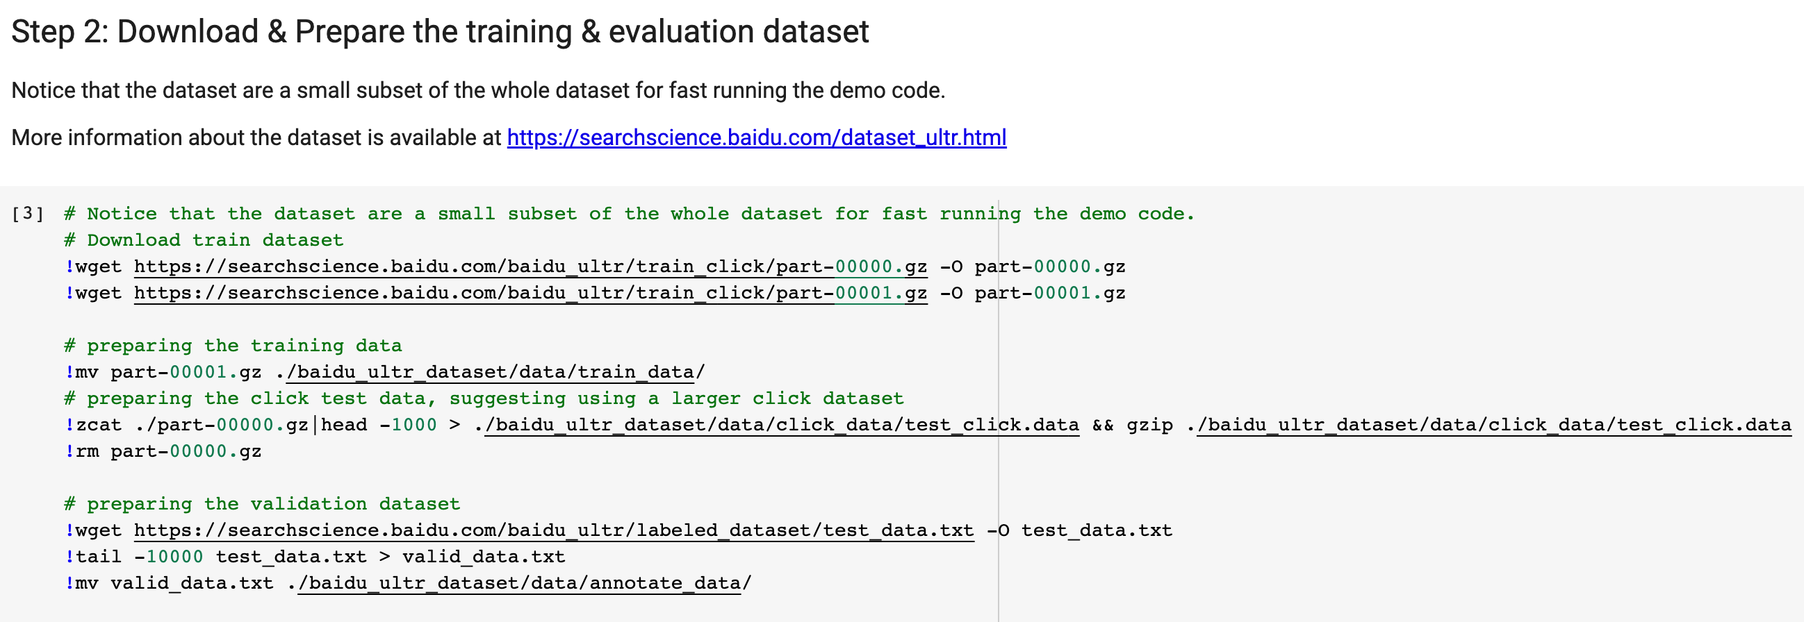
Unbiased Learning Step by Step Demo
Baidu link & Google drive are provided.

Slide 29
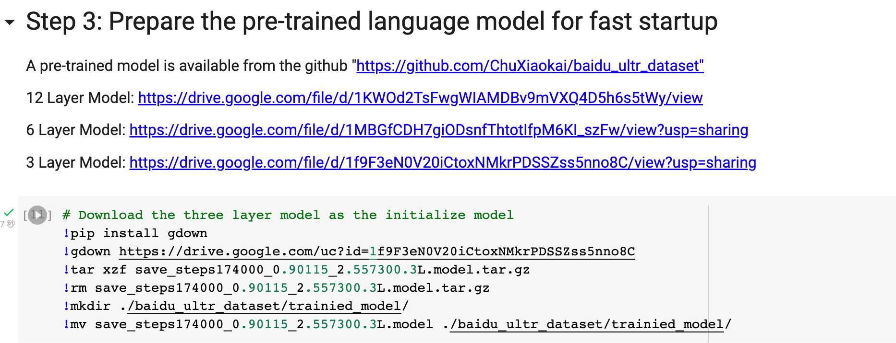
Unbiased Learning Step by Step Demo

Slide 30
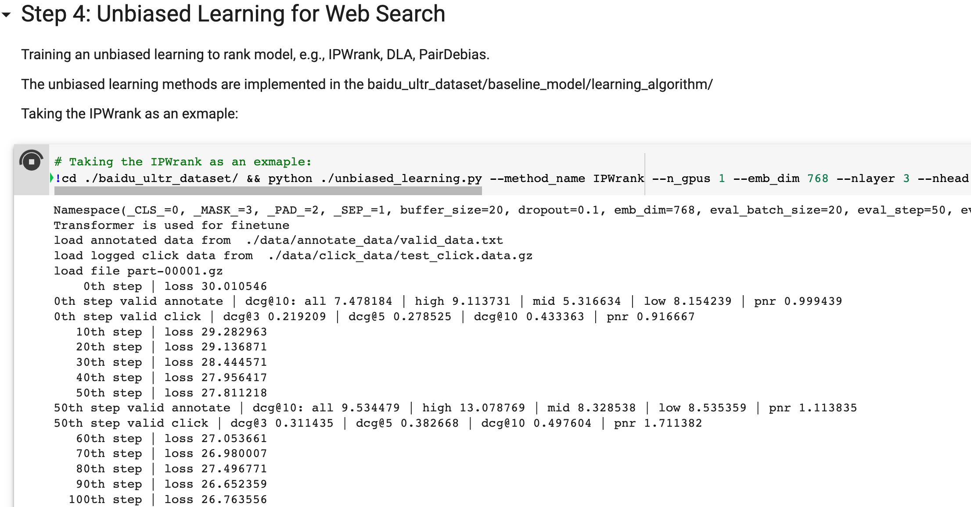
Unbiased Learning Step by Step Demo
The dcg’s difference depends on the label and bias.

Slide 31
Unbiased Learning Step by Step Demo
PNR’s difference indicates the bias.

Slide 32
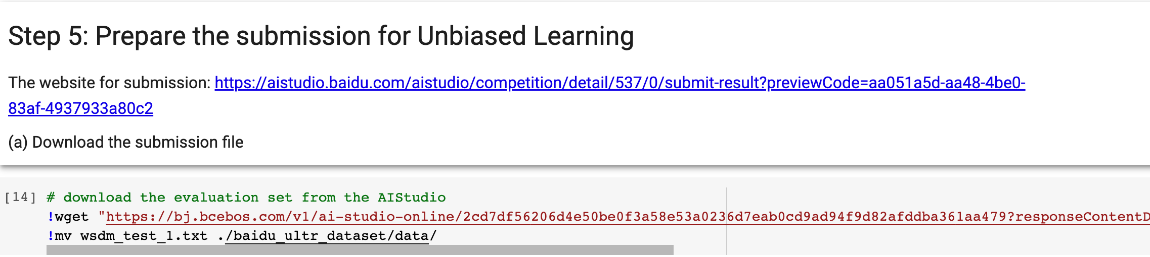
Unbiased Learning Step by Step Demo

Slide 33
Task 2: Pre-training for Web Search
Pre-train a PLM with the Large Scale Web Search Session Data and finetune the PLM with the Expert Annotation Dataset.
The award will only be honored to PaddlePaddle submission.
The award will be honored to the teams with the code that can reproduce their results.
Evaluation Metric DCG@10:

Slide 34
Task 2: Pre-training Step by Step Demo
Task Description
Pre-train a PLM with the Large Scale Web Search Session Data and finetune the PLM with the Expert Annotation Dataset.
The award will only be honored to PaddlePaddle submission.
The award will be honored to the teams with the code that can reproduce their results.
Evaluation
Evaluation Metric DCG@10:

Slide 35
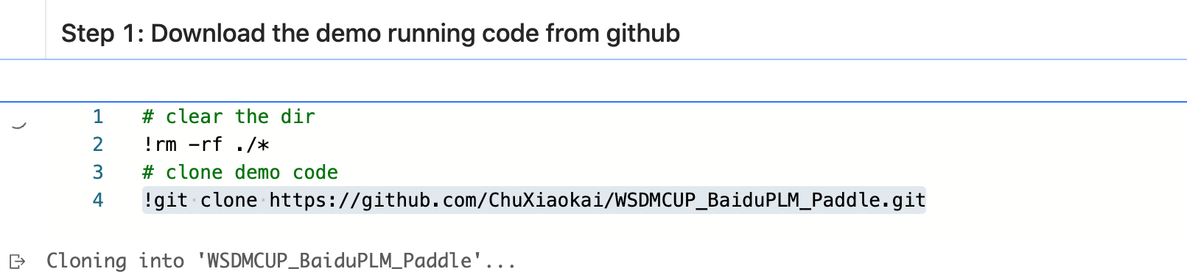
Pre-training Step by Step Demo
Running Demo : https://aistudio.baidu.com/aistudio/projectdetail/4821122?contri
butionType=1&sUid=104917&shared=1&ts=1666082935207

Slide 36
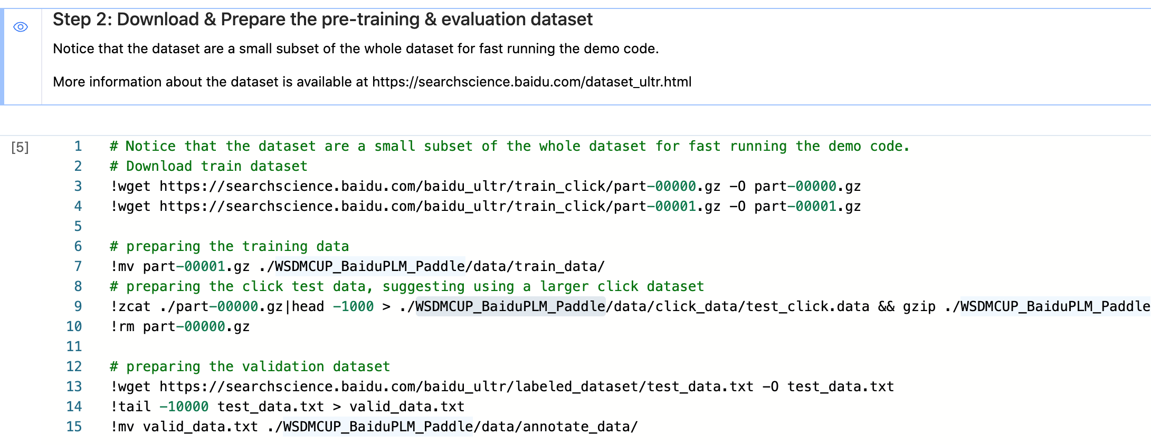
Pre-training Step by Step Demo

Slide 37
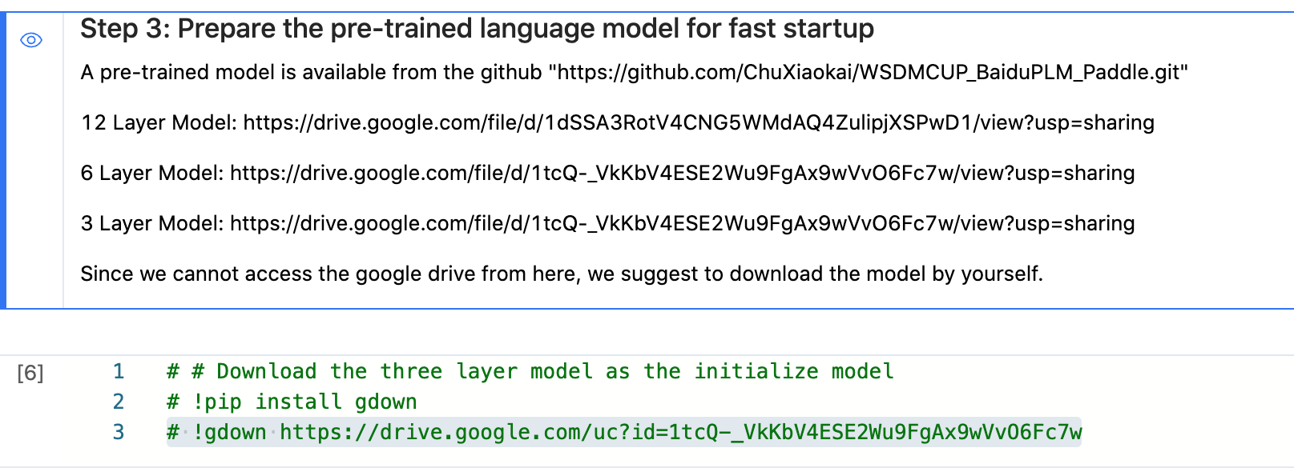
Pre-training Step by Step Demo

Slide 38
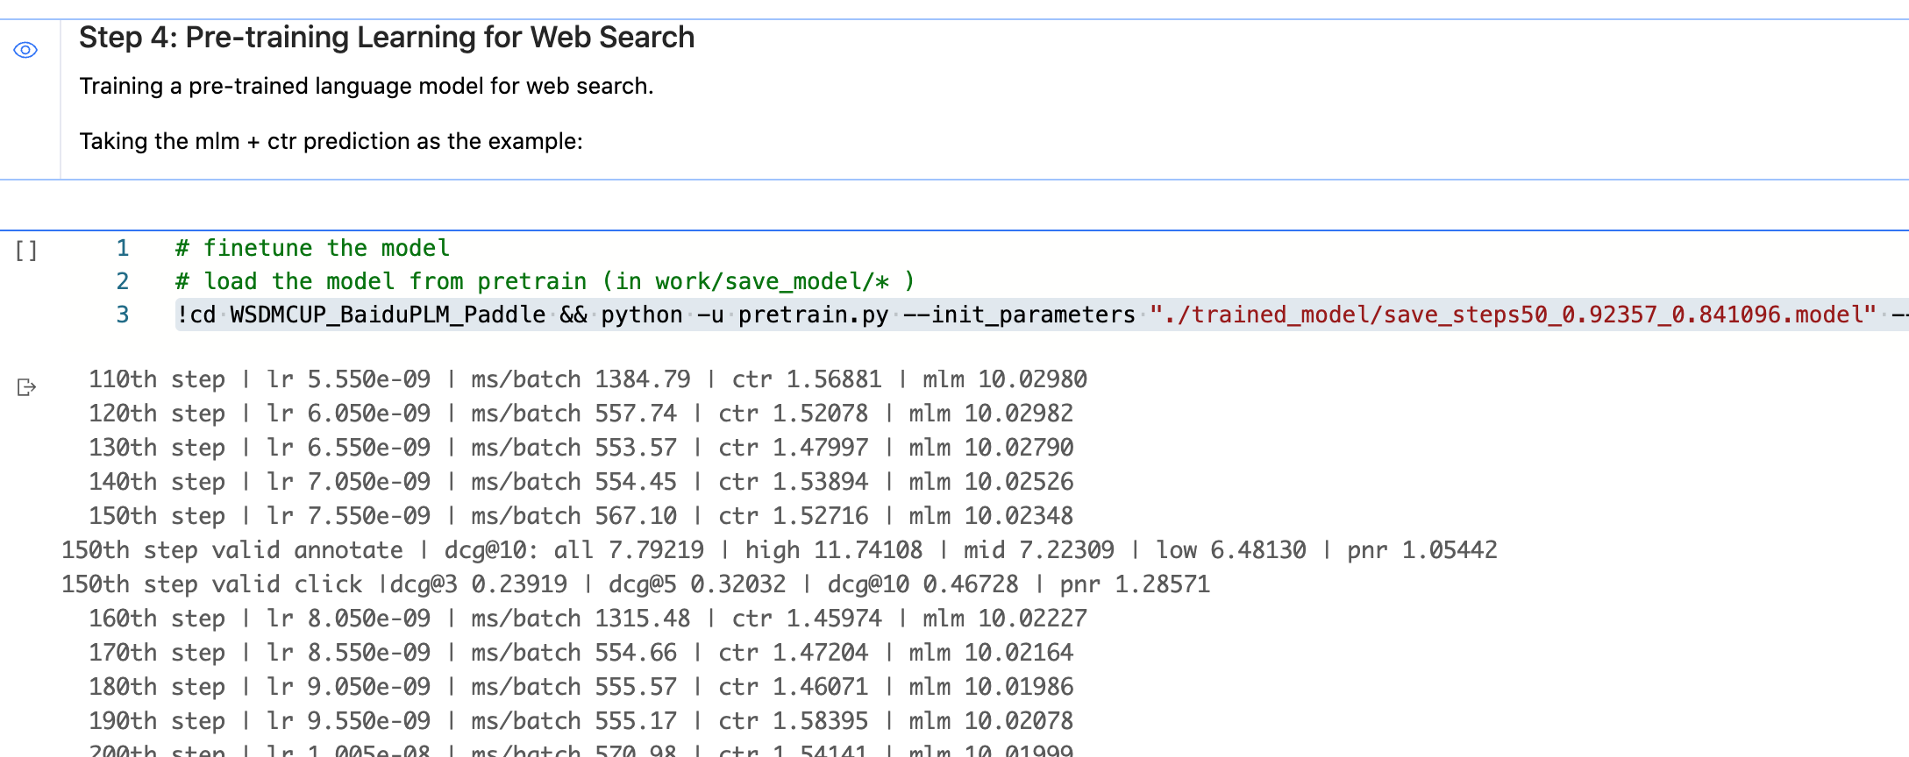
Pre-training Step by Step Demo

Slide 39
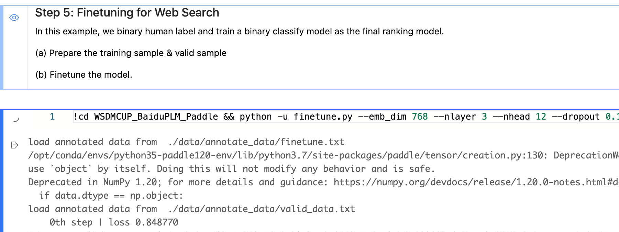
Pre-training Step by Step Demo

Slide 40
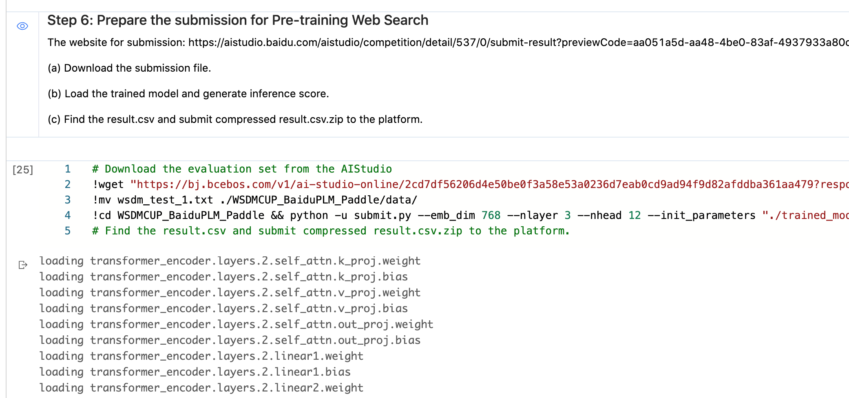
Pre-training Step by Step Demo

Slide 41
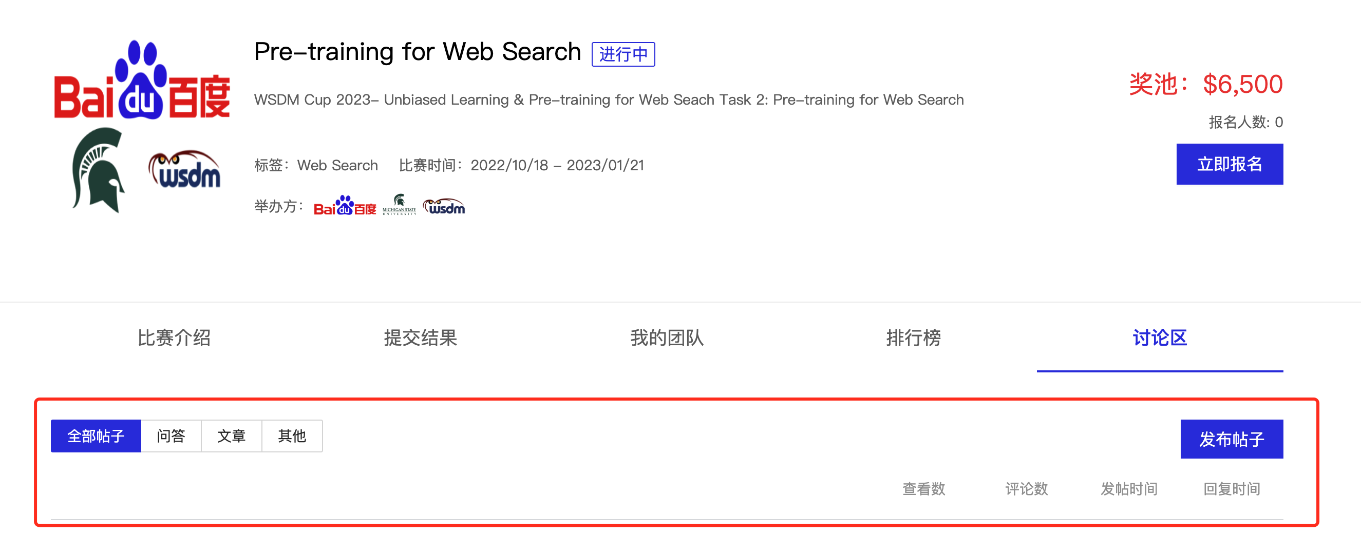
Discussion

Slide 42
Experiments & Data Analysis & Further Discussion

Slide 43
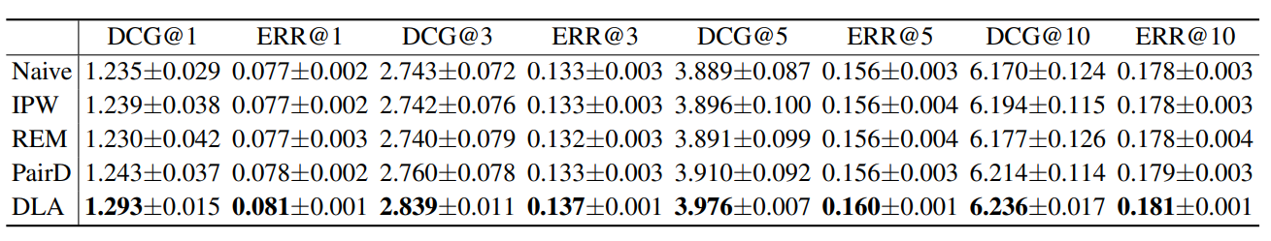
Primary Experiments
Table 4: Comparison of unbiased learning to rank (ULTR) algorithms with different learning paradigms on Baidu-ULTR using cross-encoder as ranking models. The best performance is highlighted in bold
No algorithm shows much better result than the naïve algorithm
DLA perform best across all methods
Notes:
1) No ULTR algorithms provide satisfying results since they only take the position-related biases into consideration.
(2) The DLA algorithm performs best across all algorithms, showing its robustness on the real dataset. (3) The naive algorithm shows comparable performance with IPW, even better than REM and PairD. It reveals that real-world user feedback can be more complex than synthetic feedback generated with specific user behavior assumptions like position-dependent click model [18].

Slide 44
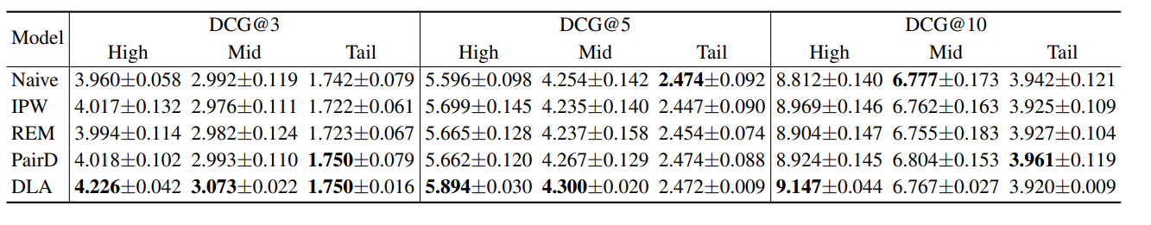
Performance on query with different frequency
Table 5: Performance comparison of evaluation ULTR algorithms versus different search frequencies. The best performance is highlighted in boldface.
All algorithms performance drop from high to tail
Naïve algorithm shows good performance in Tail query
Notes:
The reason for DLA works well is that DLA algorithms in the further algorithm.

Slide 45
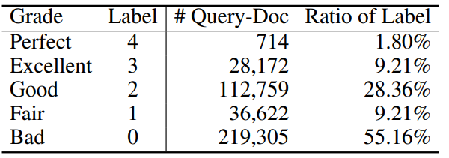
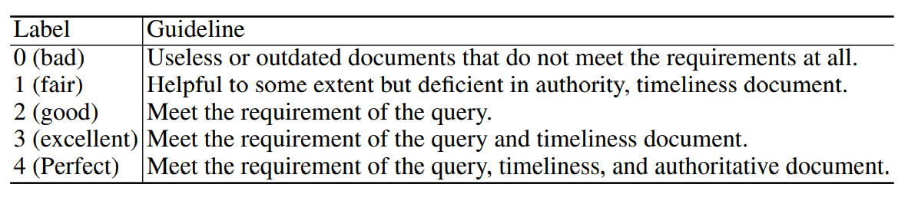
Data Analysis – Expert Annotation
Table 3: Distribution of Relevance Label.
Perfect only occupies 1.8%
Bad documents take over 50% document
Table 4: The general guideline of annotation.
Notes:
The main purpose of these guidelines is to reduce the amount of disagreement across expert annotators.
Limitation here is that, for

Slide 46
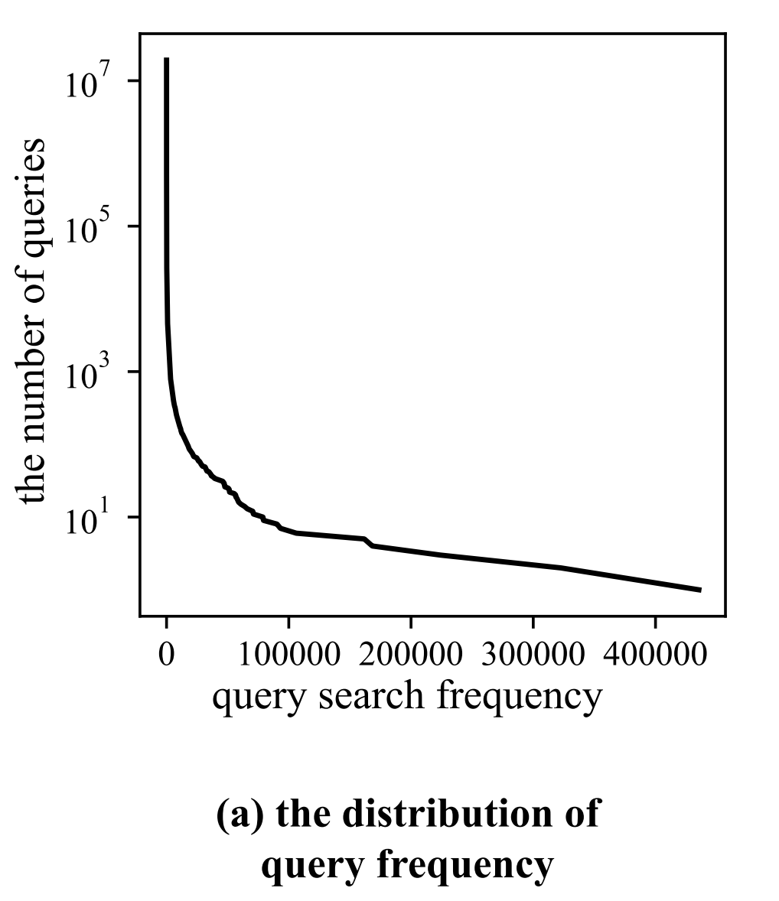
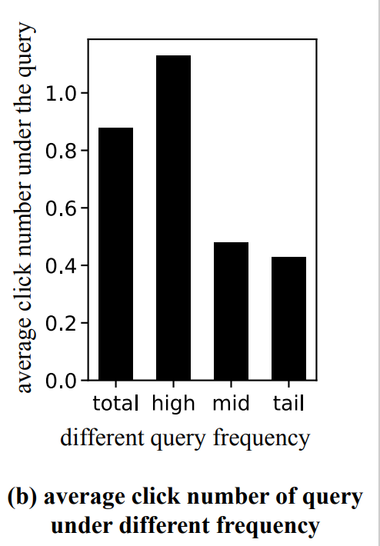
Data Analysis – Long-tail distribution
Long tail distribution appears in many behavior. For example, Over 60% searches are based on top 10% high frequency.
Notes:
Here the img should be redraw

Slide 47
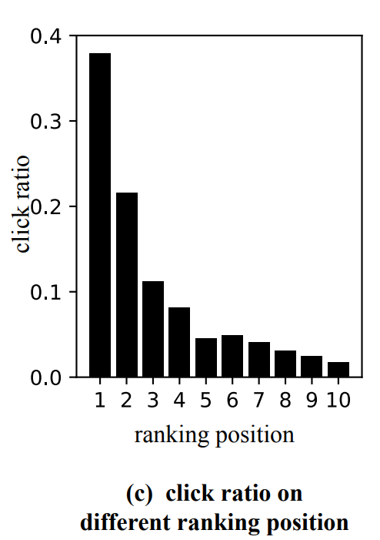
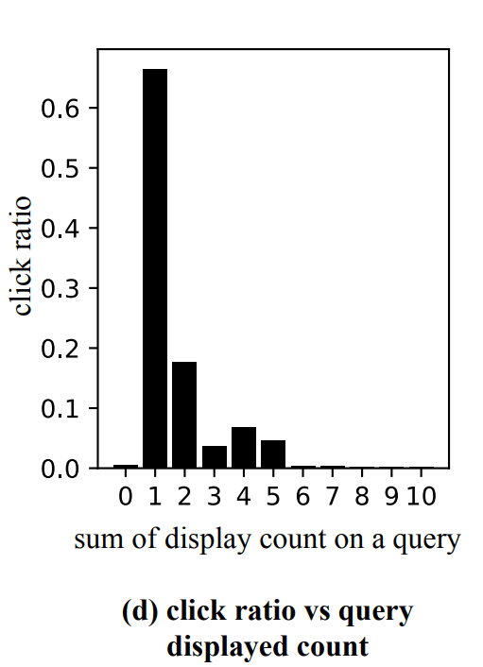
Data Analysis – click, query, displayed features
Click shows strong correlation with displayed feature.
Click shows correlation with query frequency.

Slide 48
Further Discussion
Biases in Real-World User feedback
Long-tail Phenomenon
Mismatch between Training and Test
In training stage, only top-10 documents recorded.
In test stage, top-30 documents and further documents samples
Notes:
Causal Discovery
Multi-task Learning

Slide 49
Thanks!

